Slide 1
Week 03
PROCESSORS & MEMORY

Slide 2
How Computers Represent Data
Number systems
  A manner of counting
  Several different number systems exist
Decimal number system
  Used by humans to count
  Contains ten distinct digits
  Digits combine to make larger numbers

Slide 3
How Computers Represent Data
Binary number system
  Used by computers to count
  Two distinct digits, 0 and 1
  0 and 1 combine to make numbers

Slide 4
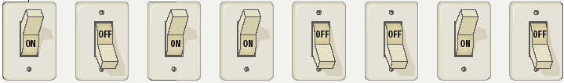
How Computers Represent Data
Bits and bytes
  Binary numbers are made of bits
  Bit represents a switch
  A byte is 8 bits

Slide 5
How Computers Represent Data
Text codes
  Converts letters into binary
  Standard codes necessary for data transfer
  ASCII
    American English symbols
    8 bit code
  Extended ASCII
    Graphics and other symbols
  Unicode
    All languages on the planet
    4 byte code
    4 billion different characters
Notes:
Insider information
Windows XP, Mac OS X and newer flavors of Linux are fully Unicode compatible.

Slide 6
How Computers Process Data
The CPU
  Central Processing Unit
  Brain of the computer
  Control unit
    Controls resources in computer
    Instruction set
  Arithmetic logic unit
    Simple math operations
    Registers

Slide 7
Control Unit
One of the two basic components of CPU
Acts as a central nervous system of a computer
Selects and interprets program instructions and coordinates execution
Has some special purpose registers and a decoder to perform these activities

Slide 8
Arithmetic Logic Unit
Actual execution of instructions
Has some special purpose registers
Has necessary circuitry to carry out all the arithmetic and logical operations included in the CPU and instruction set

Slide 9
Instruction Set
CPU has a built-in ability to execute a particular set of instructions called its instruction set
Most CPUs have 200 or more instructions such as add, subtract, compare in their instruction set
CPUs made by different manufacturers have different instruction sets
Most CPU instruction set includes instruction set of its predecessor CPU, this is known as backward compatibility.

Slide 10
Registers
Special Memory units, called registers, are used to hold information on a temporary basis as the instruction are interpreted and executed by the CPU
Registers are the part of CPU ( not main memory) of a computer
The length of a register known as word size, equals the number of bits it can store
With all other parameters being the same, a CPU with 32-bit registers can process data twice larger than with 16-bit registers

Slide 11
How Computers Process Data
Machine cycles
  Steps by CPU to process data
  It consists of two steps:
  Instruction cycle
    CPU gets the instruction- fetching
    CPU decodes the instruction- decoding
  Execution cycle
    CPU performs the instruction- executing
    Store the results- storing
  Billions of cycles per second (BIPS)
  Pipelining processes more data
Notes:
Insider information
More pipelines mean a faster and more efficient CPU. The current fastest CPU on the market, the Apple G5 has 80 pipelines!

Slide 12
Processor speed
Computer has a built-in system clock that emits millions of regularly spaced electric pulses per second ( known as clock cycles)
It takes one cycle to perform a basic operation, such as moving a byte of data from one memory location to another
Normally, several clock cycles are required to fetch, decode and execute a single program instruction
Hence, shorter the clock cycle, faster the processor
Clock speed (number of clock cycles per second) is measured in Megahertz or Gigahertz

Slide 13
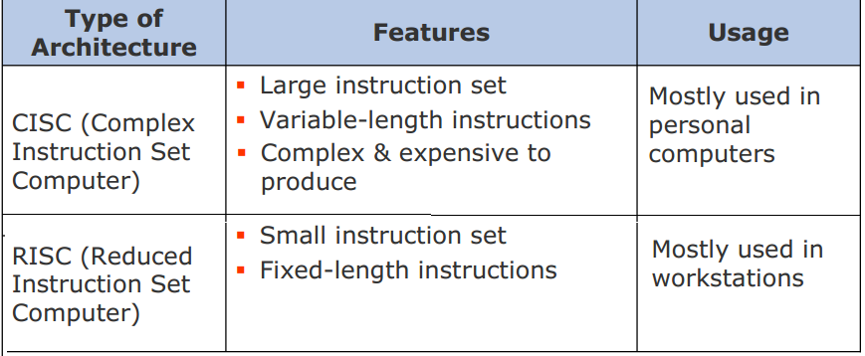
Types of Processors

Slide 14
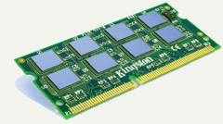
How Computers Process Data
Memory
  Stores open programs and data
  Small chips on the motherboard
  More memory makes a computer faster

Slide 15
RAM
Also known as Primary Storage
A computer’s motherboard is designed in a way that the memory capacity can be enhanced by adding more memory chips
Data in RAM has an address
CPU reads data using the address

Slide 16
ROM
Non-volatile
Read Only Memory (ROM) contains set of start-up instructions called Basic Input Output System (BIOS)
BIOS contains another set of routines which endure that system is working properly and all hardware devices are present. This routine is called Power On Self Test (POST)
Data can be read and used but cannot be changed
ROMs are usually used to store programs and data, which don’t change and are frequently used. For example, system boot program

Slide 17
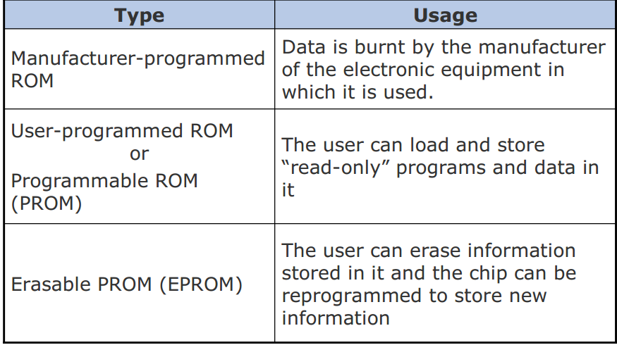
Types of ROM

Slide 18
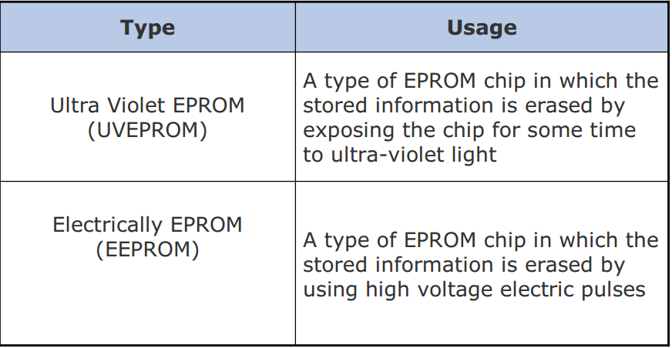
Types of EPROM

Slide 19
Cache Memory
Cache memory
  Very fast memory
  Minimizing the memory-processor speed mismatch
  Small memory between CPU & main Memory whose processing speed is closer to the processing speed of CPU
  Pronounced as “cash”
  Holds common or recently used data
  Speeds up computer processing
  Most computers have several caches
  L1 holds recently used data
  L2 holds upcoming data
  L3 holds possible upcoming data

Slide 20
How Computers Process Data
Flash memory
  Special form of nonvolatile memory
  Computers can store all types of data -- digital photographs, music files, wor­d processing documents, PDFs and countless other forms of media.
  But sometimes your computer's hard drive isn't exactly wher­e you want your information.
  Portable devices with electronic memory
  Camera cards

Slide 21
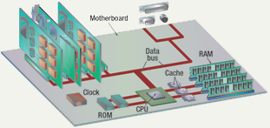
Components affecting Speed

Slide 22
Affecting Processing Speed
Registers
  Number of bits processor can handle
  Word size
  Larger indicates more powerful computer
  Increase by purchasing new CPU

Slide 23
Affecting Processing Speed
Increase RAM
  The more the RAM the faster the computer!
Virtual RAM
  Computer is out of actual RAM
  File that emulates RAM
  Computer swaps data to virtual RAM
    Least recently used data is moved

Slide 24
Affecting Processing Speed
The computer’s internal clock
  Quartz crystal
  Every tick causes a cycle
  Speeds measured in Hertz (Hz)
    First PC operated at 4.77 MHz
    Modern machines use Giga Hertz (GHz)
Notes:
Teaching tip
Spend a little time here discussing over clocking. Over clocking causes the computer to run faster than designed. Possibly, you have students that can share stories of over clocking.

Slide 25
Affecting Processing Speed
The bus
  Electronic pathway between components
  2 types of buses are there
    or external (expansion) bus- connects external devices, such as keyboard, mouse to the CPU
    internal (system) bus- resides on motherboard & connects CPU to other components that reside on mother board
    System bus has two parts- data bus, address bus

Slide 26
Parts of System Bus
5A-<number>
Data bus
  Bus is a group of wires
  Each wire can transfer one bit at a time
  Eight-wire bus can move how many bytes?
  Newer model of computers has 64-bit data bus – FrontSide bus
  The faster the bus can move data the faster the computer will be!
Address Bus
  Connects CPU and RAM and carries only memory addresses (remember each byte in RAM is associated with a number, which is a memory address)

Slide 27
Affecting Processing Speed
Universal Serial Bus (USB)
  Connects external devices
  Hot swappable
  Allows up to 127 devices
  Cameras, printers, and scanners

Slide 28
Affecting Processing Speed
Cache memory
  Cache is the fastest type of memory and a computer with more L2 cache or L3 cache will be capable of storing more instructions and send those instructions to the processor more efficiently.

Slide 29
Comparing Processors
Speed of processor
Size of cache
Number of registers
Word size
Speed of Front side bus

